Slide 1
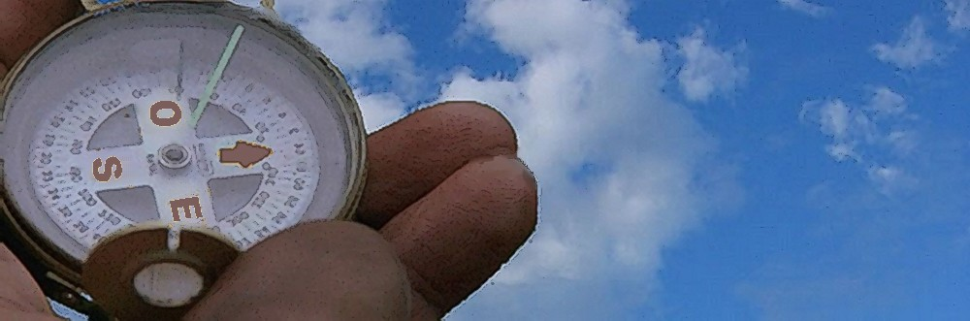


Sexual orientation and drug of choice
D. Zullino, S. Achab, G. Thorens, R. Khan, R. Manghi and Y. Khazaal
WHO collaborating center

Slide 2
Introduction
Substance use problems usually found to be more prevalent in lesbian, gay, and bisexual (LGB) populations

Slide 3
Hypotheses
Affiliation with gay culture
LGB communities centered on activities involving consumption (e.g. bars, circuit parties).
Can lead to social networks of LGB individuals with heavier consumption
Can make it more difficult to avoid triggers for substance use (e.g. bars, peers who drink)
Demographic factors (female, older age) less robust protective factors
Stress related to being a sexual minority (Minority stress model)
Bisexual identity : particularly related to increased risk for substance abuse
Green & Feinstein, 2012; Meyer, 1995, 2003

Slide 4
Methodological flaws in the existing research
Recruitment of participants from bars
Lack of appropriate comparison groups
Poor assessment of multiple dimensions of sexual orientation
Bux, 1996

Slide 5
Sexual orientation: multidimensional construct
at least 3 components
sexual attraction
refers to the desire to have sexual relations with one or both sexes
sexual behavior
refers to any mutually voluntary activity with another person that involves genital contact and sexual arousal, even if intercourse or orgasm did not occur
sexual identity
refers to personally selected labels attached to the perceptions and meanings individuals have about their sexuality
The 3 components are not perfectly correlated with one another
May be differentially associated with psychological outcomes
Green & Feinstein, 2012; McCabe et al., 2009

Slide 6
Rationale
Longitudinal studies on substance consumption rare and costly
Mostly realized in North America, where youth culture is multiple
Studies are rare in Europe
Switzerland stands in the head of European countries with regard to substance consumption rates by teenagers

Slide 7
C-SURF
Cohort study
Coordinated by
Centre hospitalier universitaire vaudois (CHUV), Lausanne
Social and Preventive Medicine Institute at Zürich University
Financial support of the Swiss National Research Foundation
Seeks to follow substance consumption by 19-year-old-young adults during at least 10 years
concerns young Swiss adults who have to go through the mandatory recruitment process at the Swiss army
covers 98% of the Swiss male 18-year-old

Slide 8
Collaborating centers
Division of Addictology, Department of mental health and psychiatry, Geneva
CHUV, University Hospital Center of the Canton of Vaud, Lausanne
IUMSP Institute of Social and Preventive Medicine, Lausanne
DUMSC, Department of Medicine and Community Health, Lausanne
AS Addiction Switzerland, Lausanne
ISPM, Institute for Social and Preventive Medicine, Zürich
Institute for Social and Preventive Medicine, Geneva
ISGF, Institute for Research in Addiction and Health, Zürich
University Hospital of Erlangen, Germany
Center for Alcohol and Addiction Studies, USA

Slide 9
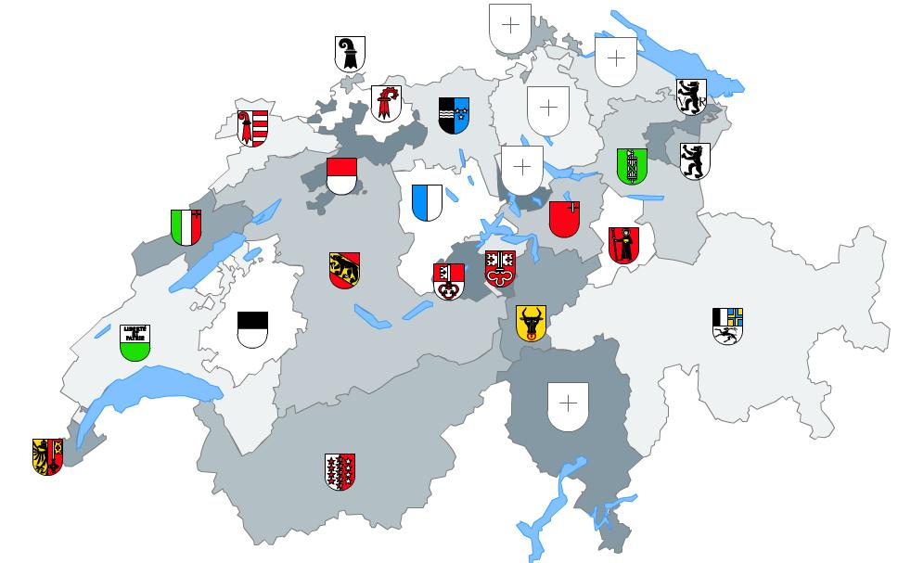
Subjects
All young men at the army recruitment centers in Lausanne, Windisch and Mels invited to participate
n = 5,387
Data collected between August 2010 and November 2011

Slide 10
Questionnaire
Online questionnaire (a hard copy sent by post if wished)
45 - 60 minutes
socioprofessional and family background
lifestyle and personality
consumption of tobacco, alcohol, cannabis and other drugs
gambling and gaming activities and use of internet
sexuality
physical and mental health
knowledge about other health-related aspects

Slide 11
Analyses
Proportions, mean values and standard deviations to describe general characteristics
Between-group differences by one-way ANOVAs and chi-square
Significance set at p<0.05
Multinomial logistic regression for association between sexual preference and a set of independent variables

Slide 12
Sexual preferences
89.7% considered themselves exclusively heterosexuals and 1% exclusively homosexuals
Bisexual attraction reported by 7.4%
1.9% avoided the question regarding their sexual preference

Slide 13
Lifetime consumption

Slide 14
Last year consumption

Slide 15
Multinomial logistic regression: Independent variables
Number of alcoholic beverages consumed during a typical day
Frequency of alcohol consumption during a typical week
Number of cigarettes smoked during a typical day
Smoking frequency in the past year
Number of illicit substances used in the past year (composite variable)

Slide 16
Multinomial logistic regression
Notes:
In the first logit, “exclusively homosexual” is compared to “exclusively heterosexual”:
Only the coefficient for the number of illicit drugs is statistically significant (OR=1.23, 95%CI [1.08; 1.41] and p=0.002)
This means that if a subject were to increase his use of illicit drugs by one unit, the odds of qualifying himself as homosexual rather than heterosexual would be expected to increase by a factor of 1.23, when all the other variables in the model are held constant.
Neither the number of cigarettes smoked nor smoking frequency nor the number of alcoholic beverages and nor the frequency of alcohol consumption were statistically associated with group membership.
In the second logit, “bisexually attracted” is compared to “exclusively heterosexual”:
Two coefficients were statistically related to group membership:
the number of alcoholic beverages (OR=0.95, 95%CI [0.91; 0.99] and p=0.009) and the number of illicit drugs used (OR=1.12, 95%CI [1.04; 1.20] and p=0.003).
The coefficient for the number of alcoholic beverages is negative: if a subject were to increase his number of alcoholic beverages by one unit, the odds of his classification into the bisexual group rather than into the heterosexual group would be expected to decrease by a factor of 0.95, all the other variables in the model being held constant. In other words, the more one consumes alcoholic beverages, the less likely one is to be classified into the bisexual group.
Conversely, the coefficient for the number of illicit drugs used is positively associated with group membership (OR=1.12, 95%CI [1.04; 1.20] and p=0.003). This is interpreted as follows: if a subject were to increase his number of illicit drugs by one point, the odds of his classification into the bisexual group rather than into the heterosexual group would be expected to increase by a factor of 1.12. The other variables were not statistically associated with group membership.

Slide 17
College studies
Gay men significantly less likely to binge drink than heterosexual men
Gay men significantly less likely to endorse norms that are permissive of binge drinking
Elevated rates of binge drinking in college samples canceling out the typical LGB/heterosexual differences during this period ?
Jasinski & Ford, 2008; McCabe et al, 2005

Slide 18
Conclusions
Homosexual men
Higher proportion of lifetime drug use (excepted alcohol and cannabis)
Maintain popper and amphetamine consumption until age 20
Hypothesis: gay culture effect?
Bisexual men
Higher proportion of lifetime cigarette and cannabis use
Higher tendency to maintain cigarette and cannabis use until age 20
Less drinks/day
Maintain popper and amphetamine use, but at lesser proportion than homosexual men
Hypothesis: less affiliated to gay culture, more tendency to consume for (minority)stress-reduction?

Slide 19


Service d’addictologie
Centre collaborateur OMS
pour l’enseignement et la recherche sur les addictions

